Slide 1

Project Name: Inpainting
Team: -
Students: Berkay Arpacı
Mert Yazan
Tino Margely

Slide 2
Index
Introduction
Method
Implementation
Results
Discussion

Slide 3
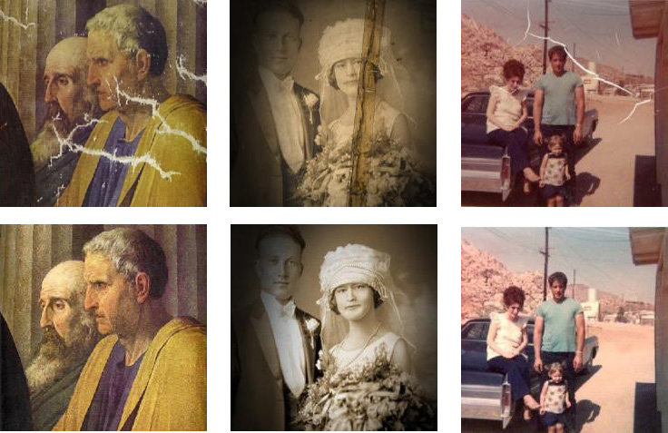
Introduction
Image inpainting is a task of reconstructing missing regions in an image.
The intensities of the pixels surrounding the image can be used to approximate the missing pixels for a smooth transition between the known pixels if the missing region is small enough.

Slide 4
Introduction
Method
Implementation
Results
Discussion

Slide 5
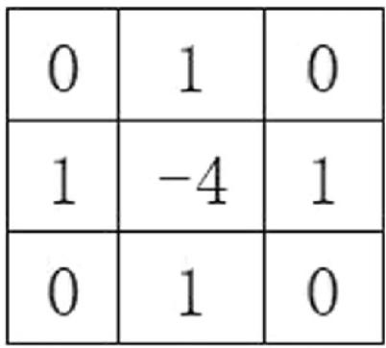
Method
The laplacian operator is used for the smoothing operation of images. Similarly, it can be used to find the intensities of the missing pixels if converted to a system of equations and solved simultaneously as a matrix equation.
4 vi, j - ( vi+1, j + vi-1, j + vi, j+1 + vi, j-1) = 0

Slide 6
Method
In order to use the equation for the missing pixels at the boundaries, it is necessary to add additional pixels to each side of the image called ghost boundaries. There are several ways to do this one of which is copying the original boundaries of the image. However, as their values are missing, another set of equations must be added to the system to be solved.
North side: v_{1, j} - v_{2, j} = 0
South side: v_{ni+2, j} - v_{ni+1, j} = 0
West side: v_{i, 1} - v_{i, 2} = 0
East side: v_{i, nj+2} - v_{i, nj+1} = 0

Slide 7
Method
Finally, the pixels whose intensities are known must be equated according to the mask specifying the positions of the missing pixels.
vi, j = ui, j

Slide 8
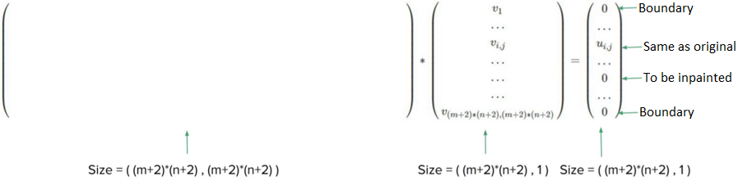
Method
The system is converted to a matrix equation to solve for the intensity vector formed which will be converted back to an image. After the removal of the ghost boundaries the resultant image is obtained.

Slide 9
Introduction
Method
Implementation
Results
Discussion

Slide 10
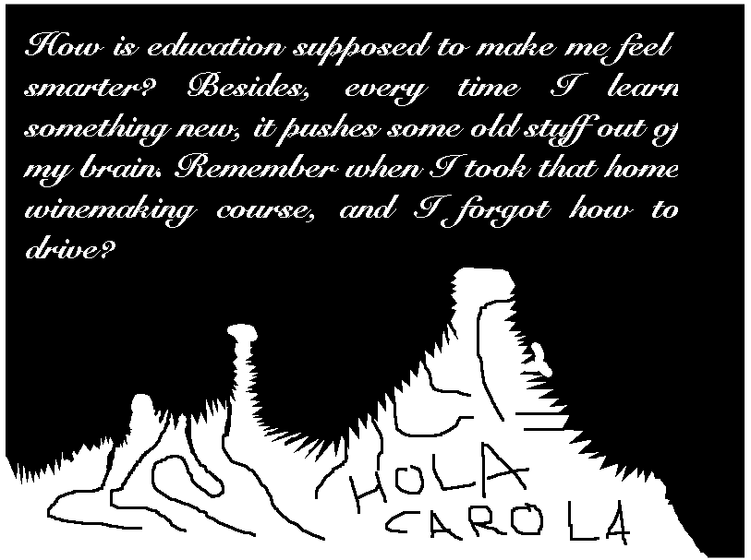
Implementation
In order to extract the mask from the image, the intensities at the red part of the image are checked and found to be purely red (255, 0, 0).
mask = (I_ch1 == 1 & I_ch2 == 0 & I_ch3 == 0);

Slide 11
Implementation
According to the syntax of the sparse function, the coefficients are defined together with their positions. Therefore, for loops for the ghost boundaries and inner points are used to form the coefficient matrix.
West
East
South
idx_Ai(idx)=p;
idx_Aj(idx) = p;
a_ij(idx) = 1;
idx=idx+1;
idx_Ai(idx) = p;
idx_Aj(idx) = p+(ni+2);
a_ij(idx) = -1;
idx=idx+1;
b(p) = 0;
idx_Ai(idx)=p;
idx_Aj(idx) = p;
a_ij(idx) = 1;
idx=idx+1;
idx_Ai(idx) = p;
idx_Aj(idx) = p-(ni+2);
a_ij(idx) = -1;
idx=idx+1;
b(p) = 0;
idx_Ai(idx)= p;
idx_Aj(idx) = p;
a_ij(idx) = 1;
idx=idx+1;
idx_Ai(idx) = p;
idx_Aj(idx) = p-1;
a_ij(idx) = -1;
idx=idx+1;
b(p) = 0;

Slide 12
Implementation
The mask is checked for the inner points and the corresponding equation is used accordingly.
idx_Ai(idx)=p;
idx_Aj(idx) = p-(ni+2);
a_ij(idx) = -1;
idx=idx+1;
idx_Ai(idx) = p;
idx_Aj(idx) = p-1;
a_ij(idx) = -1;
idx=idx+1;
% for the center pixel
idx_Ai(idx)=p;
idx_Aj(idx) = p;
a_ij(idx) = 4;
idx=idx+1;
idx_Ai(idx) = p;
idx_Aj(idx) = p+1;
a_ij(idx) = -1;
idx=idx+1;
idx_Ai(idx) = p;
idx_Aj(idx) = p+(ni+2);
a_ij(idx) = -1;
idx=idx+1;
b(p) = 0;
From the Original Image
idx_Ai(idx) = p;
idx_Aj(idx) = p;
a_ij(idx) = 1;
idx=idx+1;
b(p) = f_ext(i,j);
Inpainting

Slide 13
Introduction
Method
Implementation
Results
Discussion

Slide 14
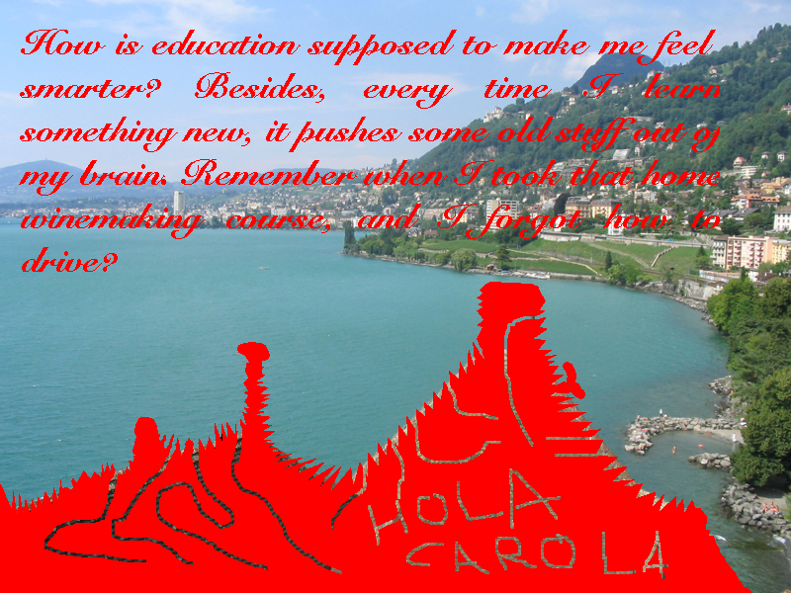
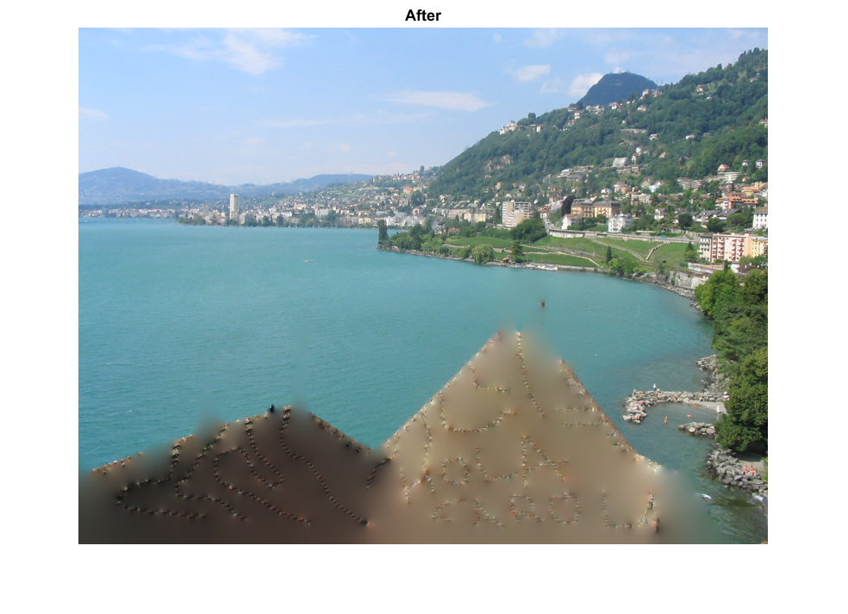
Results: Goal Image

Slide 15
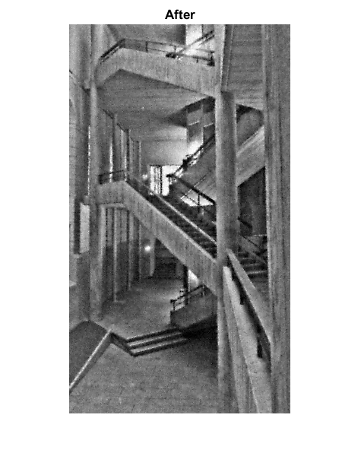
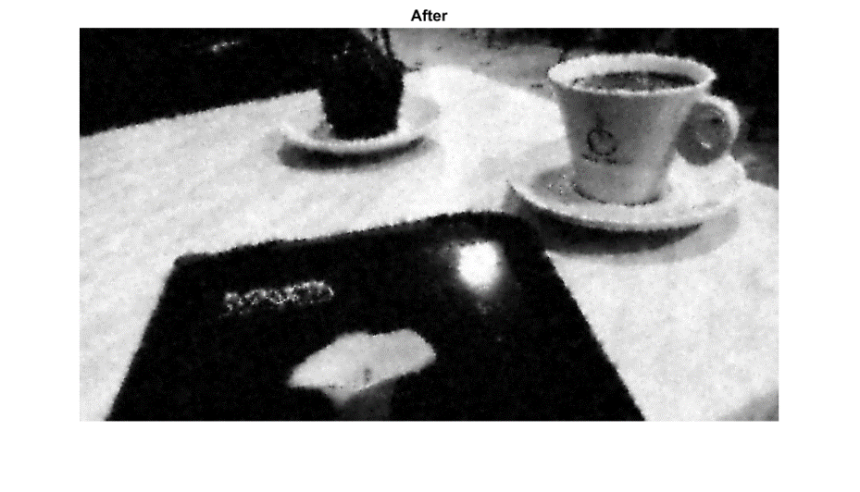
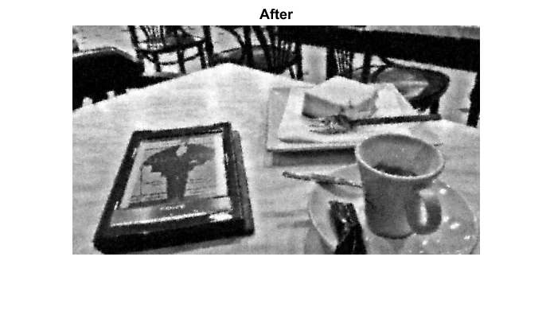
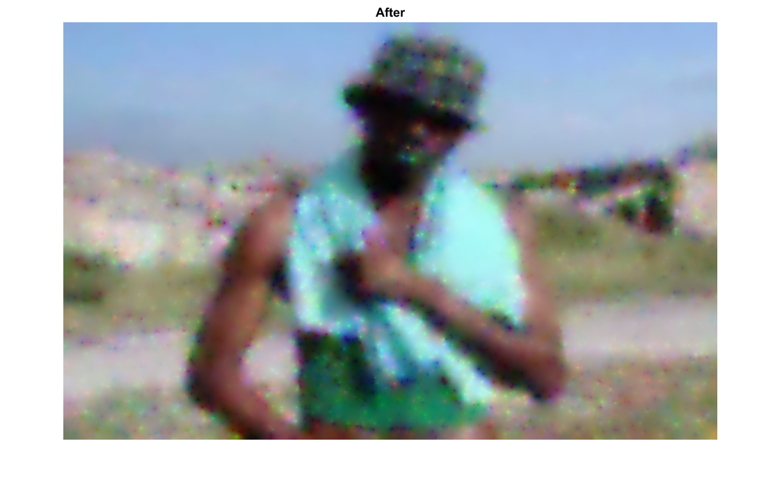
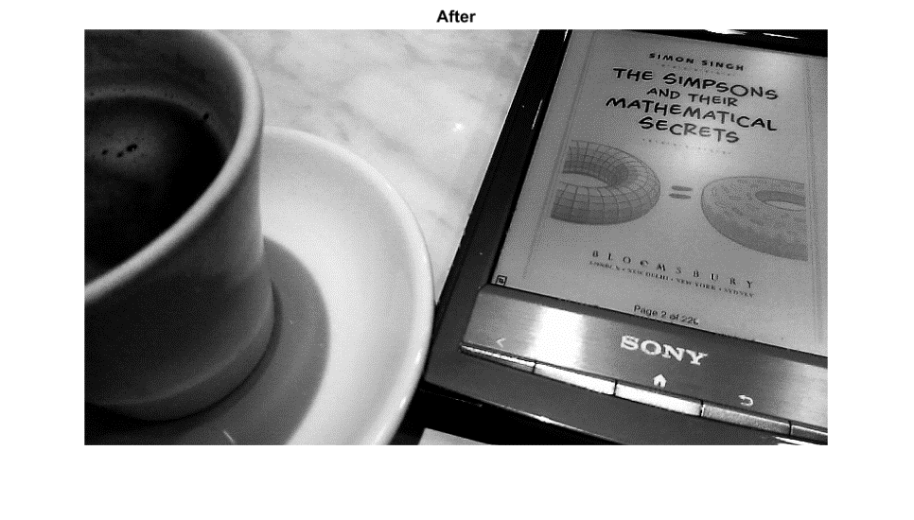
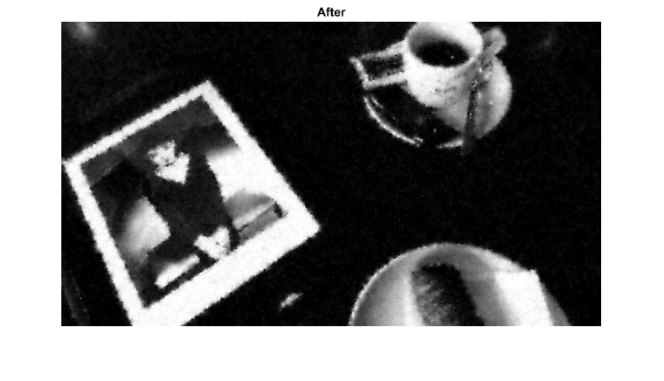
Results
The results of the first two sections of the code are as follows:

Slide 16
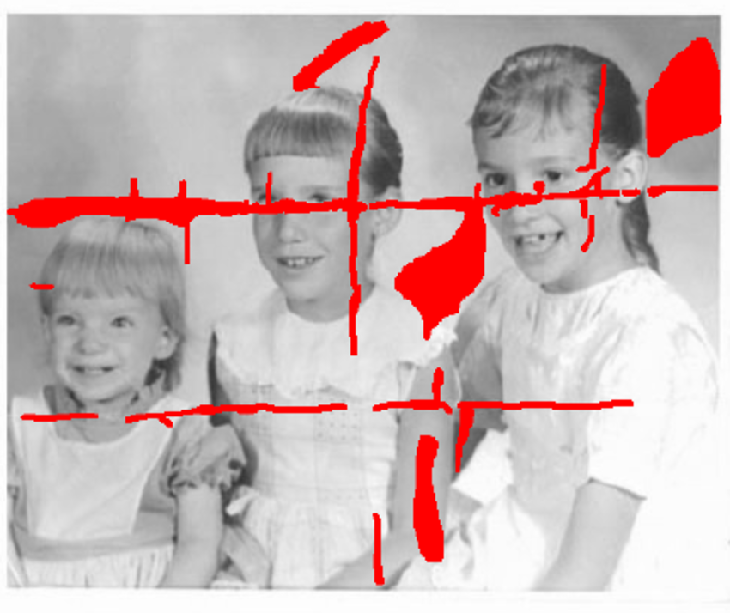
Results: Additional Example

Slide 17

Results: Additional Example
Why doesn’t it work?

Slide 18
Results: Additional Example
As the mask includes only a single colour, when there is a smooth transition between the regions, techniques like thresholding is necessary to calculate the mask. In this case, the image is inpainted by the transition pixels and therefore could not make use of the information from the real neighbouring pixels.

Slide 19
Introduction
Method
Implementation
Results
Discussion

Slide 20
Discussion
The method works well for small regions.
When it is used for large regions, it works but the resulting image becomes blurry.
The reason for this behaviour is the usage of small number of pixels compared to the missing area.
Due to the lack of information, the normally smooth transition provided by the laplacian becomes visible over the whole area.

